Slide 1
Data Link Layer
Exercises on

Slide 2
Exercise 1
110111111011111000011111011000100101011111011011111101010
Start and end of the frame?
Remove the stuffing bits
110111111011111000011111011000100101011111011011111101010
11111000011111011000100101011111011
11111000111111100010010101111111

Slide 3
Exercise 2
If the bit string 0111101111101111110 is bit stuffed using the frame delimiter 01111110, what is the output string?
Notes:
Ans: 01111011111001111101001111110

Slide 4
Exercise 3
What is the Hamming code of 0110101?
Notes:
Ans: 10001100101

Slide 5
Exercise 4
Sixteen-bit messages are transmitted using a Hamming code. How many check bits are needed to ensure that the receiver can detect and correct single bit errors? Show the bit pattern transmitted for the message 1101001100110101. Assume that even parity is used in the Hamming code.
Notes:
Parity bits are needed at positions 1, 2, 4, 8, and 16
Messages that do not extend beyond bit 31 (including the parity bits) fit.
Thus, five parity bits are sufficient.
The bit pattern transmitted is 011010110011001110101

Slide 6
Exercise 5
A 12-bit Hamming code whose hexadecimal value is 0xE4F arrives at a receiver. What was the original value in hexadecimal? Assume that not more than 1 bit is in error.
Notes:
In binary 1110 0100 1111
If we number the bits from left to right starting at bit 1, in this example, bit 2 (a parity bit) is incorrect.
The 12-bit value transmitted (after Hamming encoding) was 0xA4F.
The original 8-bit data value was 0xAF.

Slide 7
Exercise 6
What is the remainder obtained by dividing x^7 + x^5 + 1 by the generator polynomial x^3 + 1 ?
Notes:
Ans: 111

Slide 8
Exercise 7
A bit stream 10011101 is transmitted using the standard CRC method described in the text. The generator polynomial is x3 + 1. Show the actual bit string transmitted. Suppose the third bit from the left is inverted during transmission. Show that this error is detected at the receiver's end
Notes:
Ans:
The frame is 10011101.
The generator is 1001.
The message after appending three zeros is 10011101000.
The remainder on dividing 10011101000 by 1001 is 100.
So, the actual bit string transmitted is 10011101100.
The received bit stream with an error in the third bit from the left is 10111101100.
Dividing this by 1001 produces a remainder 100, which is different from zero.
Thus, the receiver detects the error and can ask for a retransmission.

Slide 9
Exercise 8
Can you think of any circumstances under which an open-loop protocol, (e.g., a Hamming code) might be preferable to the feedback-type protocols discussed throughout this chapter?
Notes:
If the propagation delay is very long, as in the case of a space probe on or
near Mars or Venus, forward error correction is indicated. It is also appropriate,
in a military situation in which the receiver does not want to disclose his
location by transmitting. If the error rate is low enough that an errorcorrecting
code is good enough, it may also be simpler. Finally, real-time
systems cannot tolerate waiting for retransmissions.

Slide 10
Exercise 9
Assume two nodes are connected via a 64 Kbps line with L=100km. A Stop and Wait protocol is active.
Minimum time needed to transfer 10 packets, where:
  Lp = packet length = 80 byte (header negligible)
  La = ACK length (RN only) = 8 byte (header negligible)

Slide 11
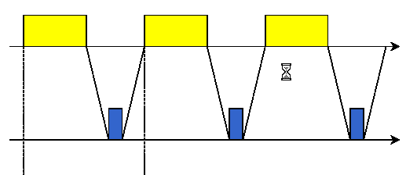
Exercise 9 - Solution
Propagation time = τ = L/c = 100000/2*10^8 = 0.5 msec
Packet trax time = Tp = Lp/v = (80*8)/64*10^3 = 10 msec
ACK trax time = Ta = La/v = (8*8)/64*10^3 = 1 msec
Ttot = (inizio trax 1^ - fine trax ultimo)
= 9(Tp + Ta + 2τ) + Tp = 118 msec

Slide 12
Exercise 10
In most networks, the data link layer handles transmission errors by requesting damaged frames to be re-transmitted. If the probability of a frame's being damaged is p, what is the mean number of transmissions required to send a frame if the acknowledgements are never lost?
Notes:
The probability, Pk, of a frame requiring exactly k transmissions is the probablity of the first k-1 attempts failing, p^^(k-1), times the probability of the k-th transmission succeeding, (1-p).
The mean number of transmissions is then just:
sum from k = 1 to infinity of kPk
which reduces to:
sum from k = 1 to infinity of k(1-p)p^^(k-1) = 1 / (1 - p)

Slide 13
Exercise 11
Assume two nodes are connected via a 64 Kbps line with L=100km. A Stop and Wait protocol is active, where:
  Lp = packet length = 80 byte (header negligible)
  La = ACK length (RN only) = 16 bit (header negligible)
  propagation time τ =1 msec
Minimum time needed to transfer 12 packets (waiting for the last ACK)?
Average time needed to transfer 12 packets when transmission has p=0.1 packet error probability?

Slide 14
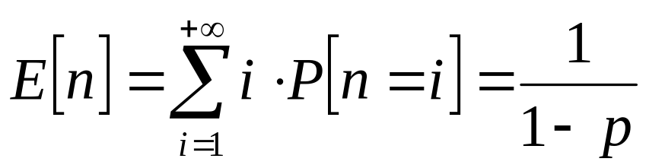
Exercise 11 - Solution
Packet trax time = Tp = Lp/v = (80*8)/64*10^3 = 10 msec
ACK trax time = Ta = La/v = 16/64*10^3 = 0.25 msec
Ttot = N(Tp + Ta + 2τ) = 147 msec
As for Exe 5, the probability P_{i} of a frame requiring exactly k transmissions is: P_{i} = P[n=i] = p^{i-1}(1-p)
Then the average number of transmissions is:
Ttot = N(Tp + Ta + 2τ) E[n] = 163.3 msec

Slide 15
Exercise 12
Assume two nodes are connected via a 6.4 Mbps line with L=100km. A GoBack-n protocol is active, with n=3.
Minimum time needed to transfer 13 packets, where:
  Lp = packet length = 80 byte (header negligible)
  La = ACK length (RN only) = 8 byte (header negligible)

Slide 16
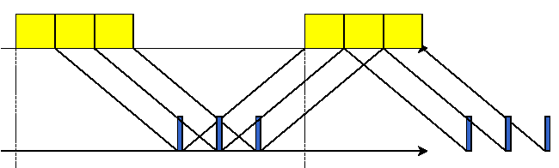
Exercise 12 - Solution
Propagation time = τ = L/c = 100000/2*10^8 = 0.5 msec
Packet trax time = Tp = Lp/v = (80*8)/6.4*10^6 = 0.1 msec
ACK trax time = Ta = La/v = (8*8)/6.4*10^6 = 0.01 msec
4 groups of 3 packets + 1 single packet
Ttot = (inizio trax 1^ - fine trax ultimo)
= 4(Tp + Ta + 2τ) + Tp = 4.54 msec

Slide 17
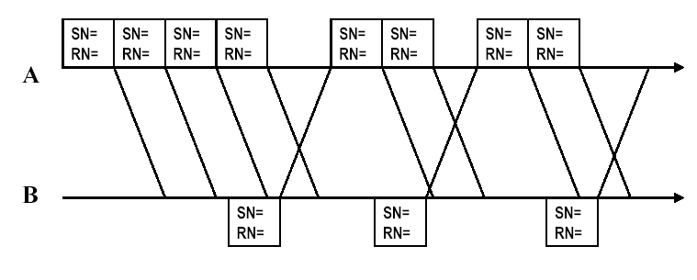
Exercise 13
Assume a GoBack-n protocol is active, with n=4 and time-out equal to 5 times the frame transmission time.
SN = Sending Number, RN = Request Number (it indicates the expected frame number, and NOT the acknowledged SN from the other side)
Conclude the following picture:
Notes:
NOTE THAT the notation for RN is different from the textbook: in all the exercises here it is the frame number which is expected by the receiver.
It does NOT correspond to the frame number just received from the transmitter!

Slide 18
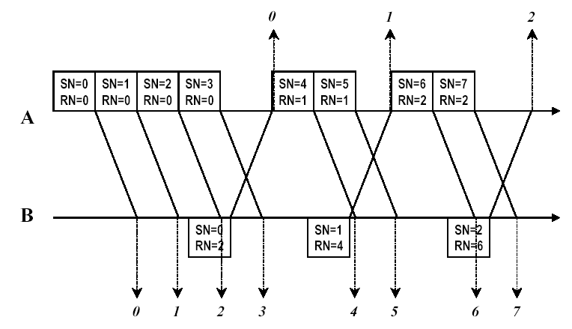
Exercise 13 - Solution

Slide 19
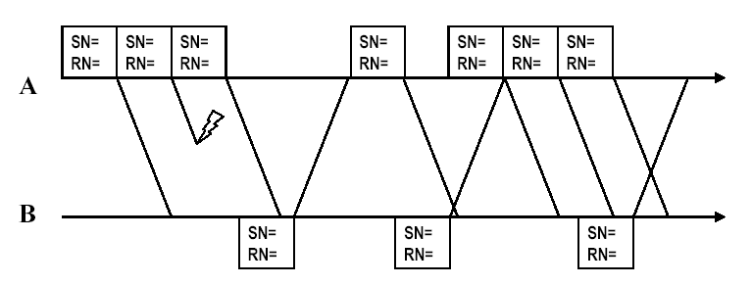
Exercise 14
Assume a GoBack-n protocol is active, with n=3 and time-out equal to 5 times the frame transmission time.
Conclude the following picture:

Slide 20
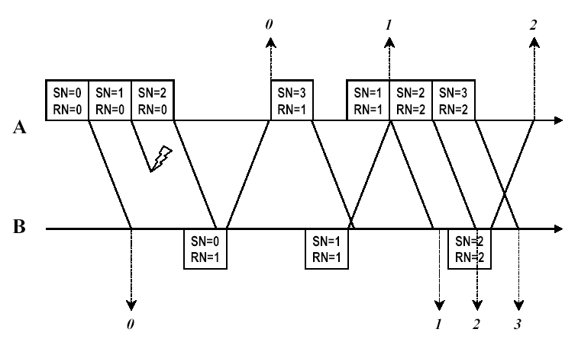
Exercise 14 - Solution

Slide 21
Exercise 15
Consider a network based on pure ALOHA with poissonian traffic
If the success probability is equal to 0.1, calculate:
  the traffic G
  throughput S
Notes:
See slide 8-9-10 from “chapter4-mac.ppt”
--------------------------
P = e^(-2G) = 0.1
-2G = ln (0.1)
a) G = -1/2 ln (0.1) = 1.151
b) S = G e^(-2G) = 0.115

Slide 22
Exercise 16
Consider a network based on slotted-ALOHA, made of three stations with these MAC address:
    A (21); B (17); C (8)
Retransmission rule after a collision:
  the station retransmit after a number of slots equal to the reminder of the division between its MAC address and 2^{k}, where k is the number of successive collisions experienced by the station itself
If the three stations collide in the first slot, when do they manage to transmit correctly their packet?
Sol:
A
B
C
A
B
A
B
C
B
A
0
1
2
3
4
5
6
7
8
9
10
11
12
13
14

Slide 23
Exercise 17
As in the previous exercise, but with 4 stations:
  A (18); B (17); C (20); D (4)
If A, B e C transmit a packet during slot 0, while D transmits a packet during slot 2, when do the stations manage to transmit correctly their packet?
Sol:
A
B
C
B
C
D
A
C
A
B
A
C
D
B
A
C
0
1
2
3
4
5
6
7
8
9
10
11
12
13
14

Slide 24
Exercise 18
Assume a maximum data field for an Ethernet frame of 1500 bytes. What is the overhead (in %) for a 4096-byte application message?
(Hint: consider 56 bytes of upper layers headers)
Notes:
Hint: the message must be segmented into multiple frames and be careful of how you consider the data field in the Ethernet frame.
---------------------------------------
The LAN data field includes 56 bytes of IP, TCP, and Appl headers leaving
1444 bytes for Appl data. A 4096 byte message segments into 3 frames with
1444 bytes payload, 1444 bytes payload, and 1208 bytes payload. Thus, we
have 3 * (56 + 26) = 3 * (22 + 20 + 20 + 16 + 4) = 246 bytes of overhead
to transport 4096 bytes, or 246 / (4096 + 246) = 5.66% overhead.

Slide 25
Exercise 19
Ethernet frames must be at least 64 bytes long to ensure that the transmitter can detect collisions. Fast-Ethernet has the same minimum frame size but can transmit 10 times faster. How is it possible to still detect collisions?
Notes:
In order to detect collisions, the station must be still transmitting when the first bit reaches the far end of
the cable. As the network speed goes up, the minimum frame length must go up or the maximum cable
length must come down proportionally.
Indeed, let: c=speed of signal (2*10^8), l = length of the cable, and s=data rate (bps)
Then the minimum frame size is: x=s*l/c.
Thus, since x is the same for both Ethernet and Fast Ethernet, and s in Fast Ethernet is 10 times as much
as in Ethernet, l, the wire length, must be 1/10 as long as in Ethernet.

Slide 26
Exercise 20
Consider building a CSMA/CD network at 1Gbps over a 1km cable with no repeaters. What is the minimum frame size? (Assume the signal speed in the cable is 200,000 Km/sec).
Notes:
In order to detect collisions, the station must be still transmitting when the first bit reaches the far end of the cable.
For a 1Km cable, the one-way propagation time is tau=5usec so 2tau=10usec (RTT). At 1 Gbps all frames
shorter than 10,000 bits can be completely transmitted in under 10msec. Thus the minimum frame size is
10,000 bits.

